Slide 1
HPRTAS
Five executable processes on Camunda 8
Hospital Patient Referral, Treatment and Administration System. A referral arrives from a GP or another hospital, and the pathway runs to the refund after a cancelled appointment.
This deck shows two things
▪ The operational diagrams - the five executable processes, one to a page
▪ The measurable acceptance criteria - AC-01 to AC-10, each with the requirement, the business rule and the scenarios that measure it
Referral and appointment · authorisation, funding and payment · clinic letter and escalation · follow-up, cancellation, enquiry and refund · the missing-information exchange
github.com/GuardFell/HPRTAS · tag submission-2026-09-29 · diagrams from models/exports/ · criteria from tests/test-plan.md

Slide 2
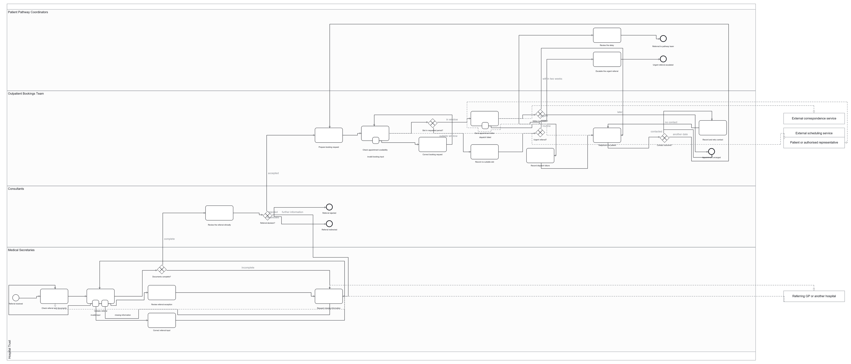
core-1 Receiving a referral and arranging the appointment
A referral arrives, its documents are checked, a Consultant decides, and the new patient appointment is found and confirmed
13 user tasks · 3 service tasks · 6 gateways, all with a default flow · 4 error catches · 10 forms bound
Participants: 5 pools / 4 lanes - Patient Pathway Coordinators, Outpatient Bookings, Consultants, Medical Secretaries · Job types: validate-referral · check-appointment-availability · send-correspondence
▪ The Consultant's acceptance gates the booking: no appointment is arranged before an accepted decision (FR-006).
▪ An appointment inside two weeks adds the telephone path to the letter path, not instead of it (FR-014).
▪ Urgent referral with no slot: it escalates out rather than re-checking - the loop DEF-11 was raised for.
HPRTAS · models/operational/core-1-referral-and-new-patient-appointment.bpmn · diagram from models/exports/ · tag submission-2026-09-29

Slide 3
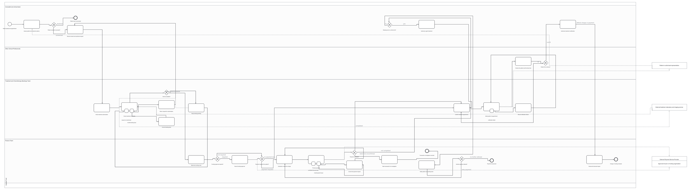
core-2 Authorising, funding and paying for treatment
Consent and clinical authorisation, the funding route, payment through the provider, the treatment booking, and the review between cycles
18 user tasks · 3 service tasks · 8 gateways, all with a default flow · 5 error catches · 16 forms bound
Participants: 5 pools / 4 lanes - Consultant and clinical team, Other Clinical Professionals, Treatment and Chemotherapy Bookings, Finance Team · Job types: check-treatment-availability · process-payment · send-correspondence
▪ The funding route is settled before confirmation: a funded or exempt route never calls the provider (FR-025).
▪ Every provider outcome is modelled: declined records no amount, and an unconfirmed payment is investigated, not retried.
▪ Card and security details are refused before the call, so only status, reference, date and amount are retained (NFR-007).
HPRTAS · models/operational/core-2-treatment-authorisation-funding-and-payment.bpmn · diagram from models/exports/ · tag submission-2026-09-29

Slide 4
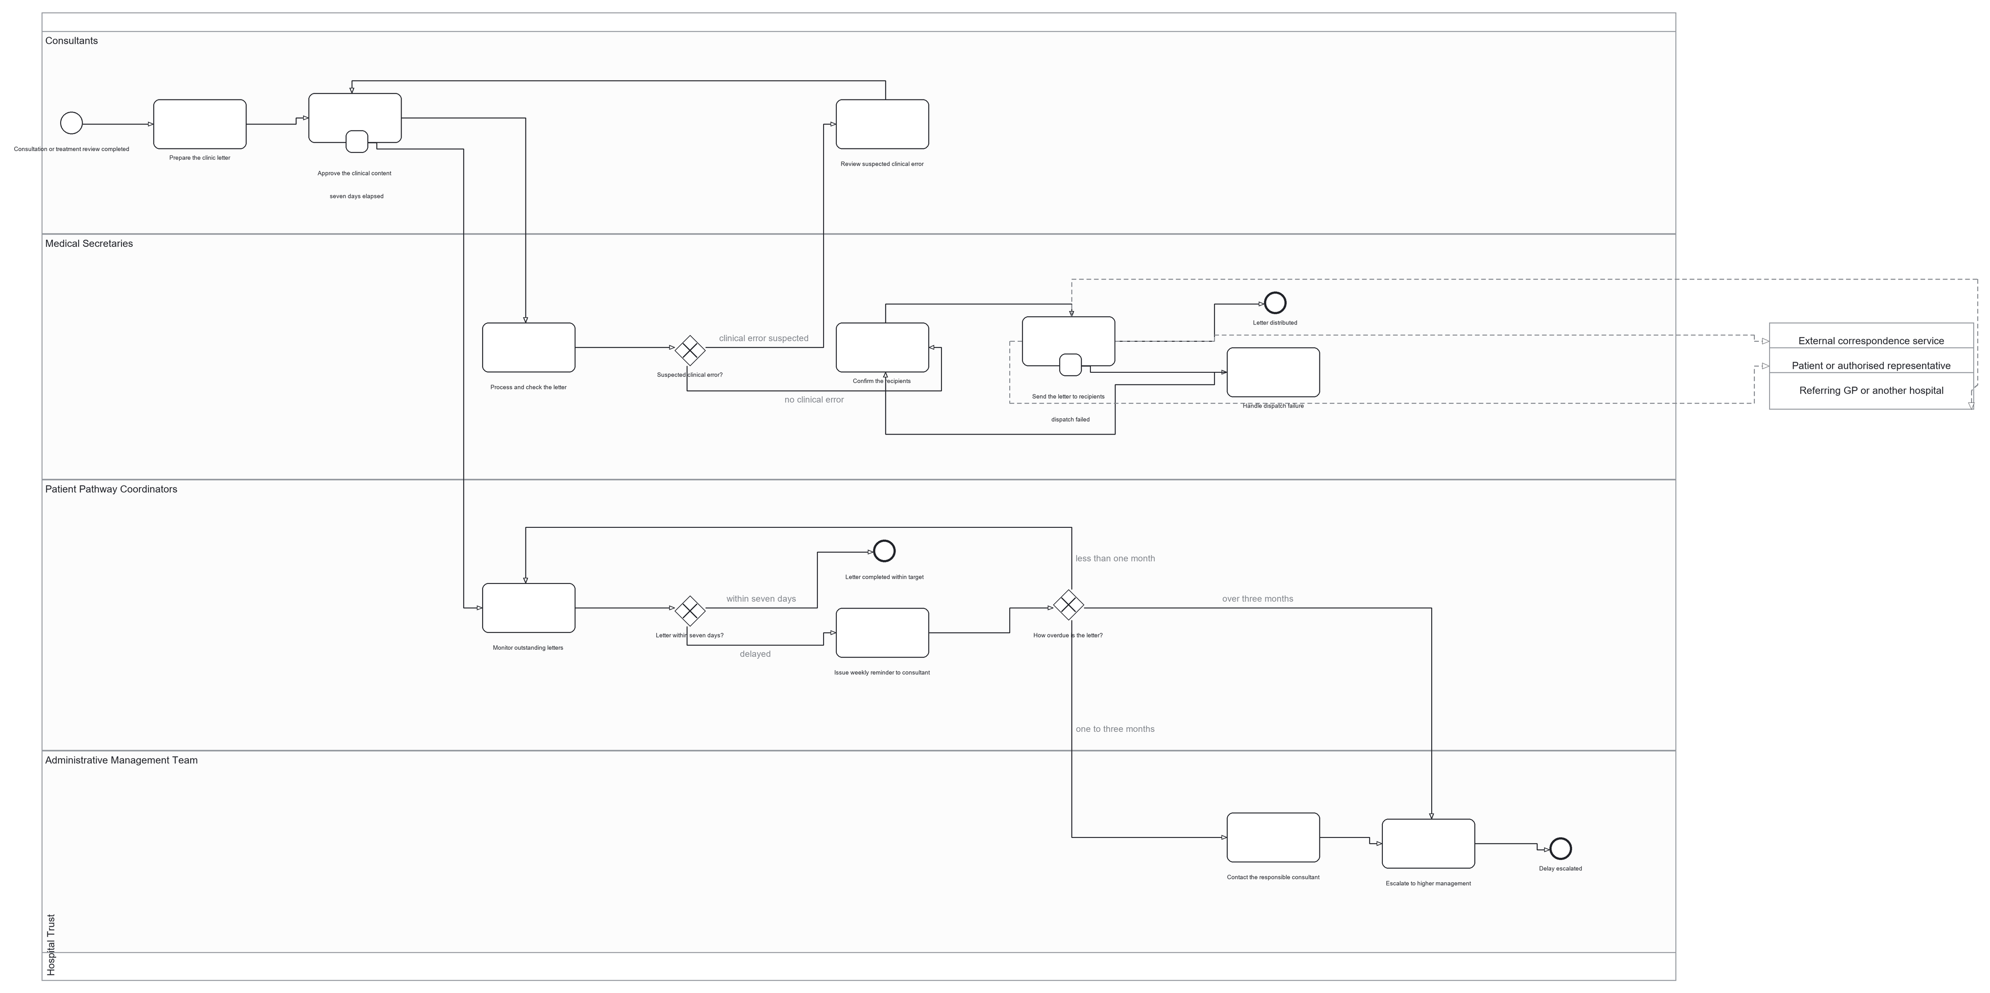
core-3 The clinic letter and the escalation when it is late
Prepare and clinically approve the letter, check it administratively, distribute it, and escalate a letter that misses its target
10 user tasks · 1 service task · 3 gateways, all with a default flow · 1 error catch + 1 timer · 8 forms bound
Participants: 4 pools / 4 lanes - Consultants, Medical Secretaries, Patient Pathway Coordinators, Administrative Management Team · Job types: send-correspondence
▪ Approval precedes distribution, and a suspected clinical error returns the letter to the Consultant, not to admin (BR-27).
▪ The seven-day target is a timer on the approval task, so a late letter needs nobody to notice it (FR-039).
▪ Escalation grows with the delay - reminder, contact, higher management - and stops once the letter is complete.
HPRTAS · models/operational/core-3-clinic-letter-and-pathway-escalation.bpmn · diagram from models/exports/ · tag submission-2026-09-29

Slide 5
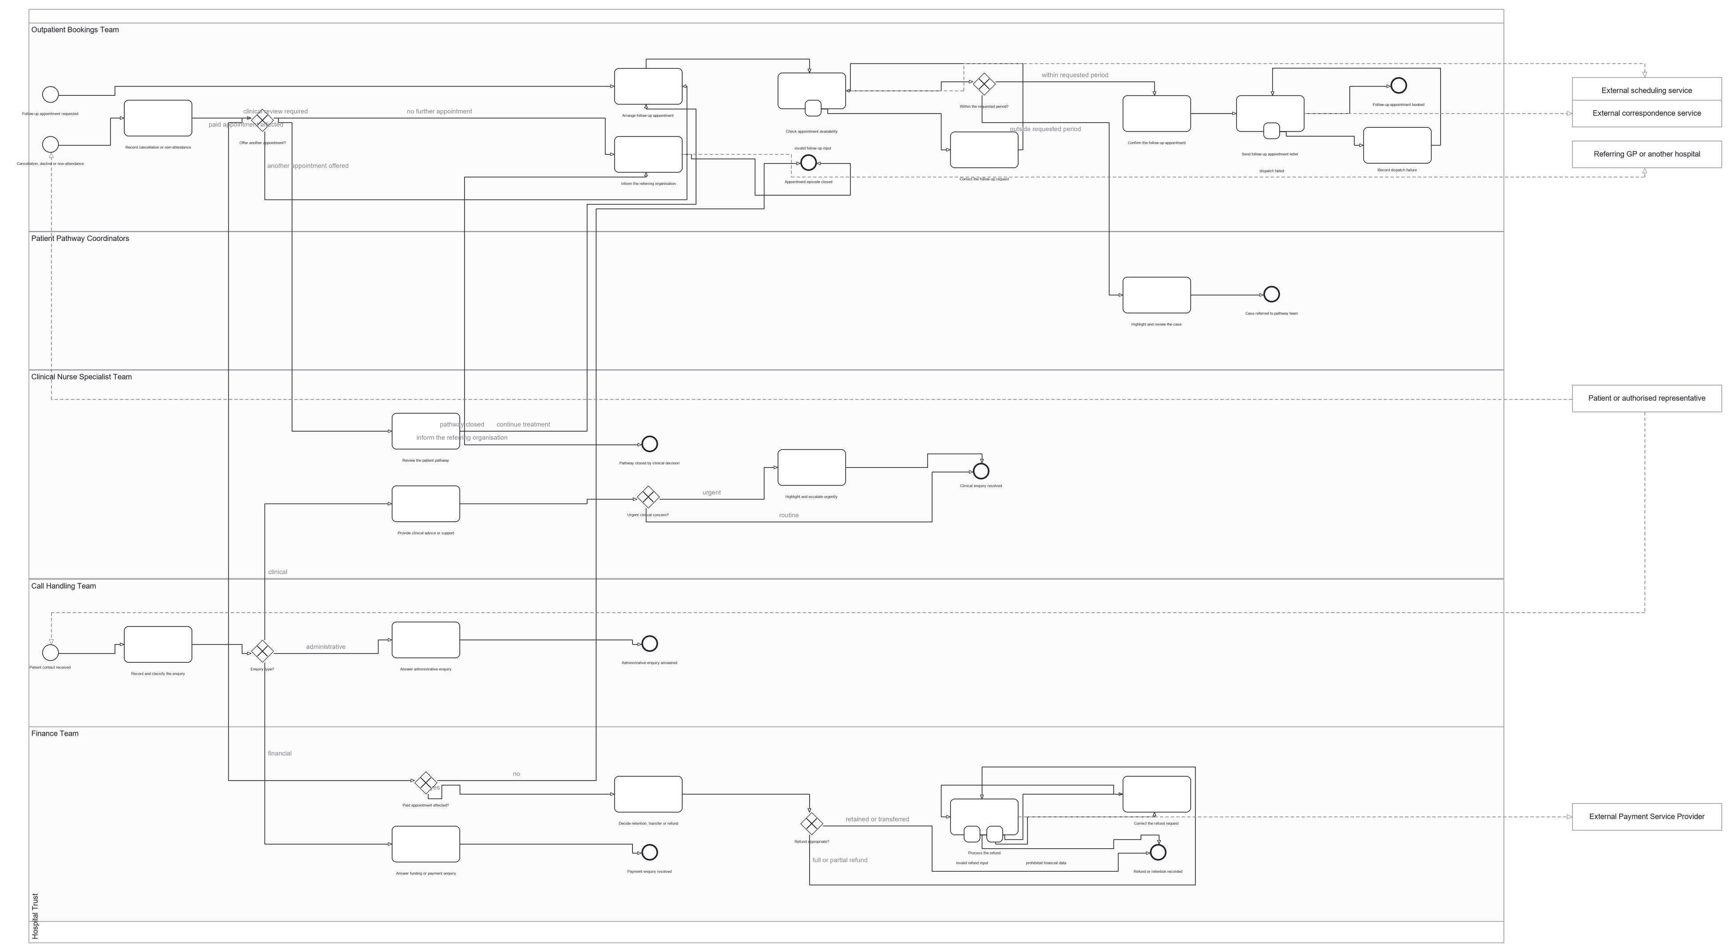
core-4 Follow-up, cancellation, enquiry and refund
After treatment: booking the follow-up, recording a cancellation or non-attendance and its decision, routing enquiries, and refunding a paid appointment
15 user tasks · 3 service tasks · 6 gateways, all with a default flow · 4 error catches · 12 forms bound
Participants: 6 pools / 5 lanes - Outpatient Bookings, Pathway Coordinators, Clinical Nurse Specialists, Call Handling, Finance Team · Job types: check-appointment-availability · process-refund · send-correspondence
▪ Three start events: one ordinary, plus message start events for a cancellation and an enquiry arriving unannounced.
▪ A clinical enquiry cannot be answered from Call Handling; it is routed to a clinical professional (FR-041).
▪ Only Finance decides retain, transfer or refund - and only against a payment this process really settled.
HPRTAS · models/operational/core-4-follow-up-cancellation-enquiry-and-refund.bpmn · diagram from models/exports/ · tag submission-2026-09-29

Slide 6
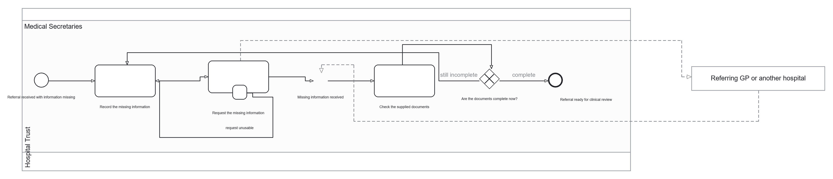
core-5 The missing-information exchange, modelled as an exchange
The Medical Secretaries record what is missing, the request is published to the referring organisation, and the process waits for the reply
2 user tasks · 1 service task · 1 gateway, with a default flow · 1 error catch · 2 forms bound
Participants: 2 pools / 1 lane - Medical Secretaries · Job types: request-referral-documents (the seventh worker)
▪ The request is published as a message; the process then waits at a catch event instead of assuming the reply.
▪ The catch event is correlated by the referral reference, so one patient's reply cannot move another patient's referral.
▪ core-1 records this step inside one process with a user task standing in for the reply; core-5 is the wait made explicit.
HPRTAS · models/operational/core-5-missing-information-message-exchange.bpmn · diagram from models/exports/ · tag submission-2026-09-29

Slide 7
Measurable acceptance criteria (1 of 2)
AC | Acceptance criterion (clear and measurable) | Requirement | Business rule | Measured by
AC-01 | A referral is registered with its referring organisation, date and reference, and its supporting information is checked against the expected list; where information is missing it is recorded and requested from the referring organisation and the referral does not go for clinical review until it is available. An accepted referral reaches a booked appointment found through the scheduling service, the booking is confirmed, and the patient is informed by letter and, where the appointment falls within the following two weeks, also contacted by telephone, with every contact attempt and its outcome recorded. | FR-001, FR-002, FR-003, FR-011, FR-012, FR-013, FR-014 | BR-01, BR-05, BR-06, BR-07, BR-08 | TC-01 Pass TC-03 Pass TC-04 Pass TC-13 Not run
AC-02 | Clinical decisions are made and recorded by an authorised clinical professional and by no other role, and no step that depends on one is reached without it: no New Patient Appointment is arranged until an authorised Consultant has accepted the referral, a Treatment Booking Request without clinical authorisation is not processed and creates no appointment, the decision on fitness to continue between chemotherapy cycles is a clinical decision, and a change to a treatment schedule is accepted only as an authorised Treatment Modification Request submitted through the system. | FR-004, FR-005, FR-006, FR-008, FR-009, FR-020 | BR-02, BR-03, BR-04, BR-10, BR-22, BR-25 | TC-02 Partial TC-06 Pass TC-14 Partial
AC-03 | The funding route is determined before a treatment appointment is confirmed, and where a charge applies the payment request is sent to the Payment Service Provider and the outcome it returns - status, transaction reference, payment date and amount - is recorded; the appointment is confirmed only once the payment is complete or an authorised exemption, funding approval or payment arrangement is recorded, a funded or exempt route results in the provider not being called at all, and a declined payment leaves no amount recorded and is reported so the patient and the responsible administrative team can be notified. | FR-025, FR-026, FR-027, FR-029, FR-030 | BR-13, BR-14, BR-15, BR-17 | TC-07 Pass TC-08 Pass
AC-04 | A step that cannot complete takes its modelled exception path instead of stalling the pathway or repeating the external action: unusable input and an unavailable external service both leave the process able to continue with the attempt recorded, and a payment taken without a returned confirmation is marked for investigation and is not automatically re-requested. | FR-018, FR-031 | BR-12, BR-18 | TC-09 Pass TC-12 Pass
AC-05 | Where no suitable appointment is available within the period the clinician requested, or the slot found falls outside it, the situation is recorded and highlighted rather than the patient being silently booked outside the requested period, and an urgent referral is handled outside the normal administrative timescales. | FR-015, FR-016, FR-023 | BR-09, BR-34 | TC-05 Pass at both levels TC-18 Pass
Each criterion is measurable because it states the condition to be met, and because it is linked to the requirement and the business rule it comes from. The scenarios beside it are the ones that measure it, and the result is the one recorded in the test plan's execution record at this commit.
HPRTAS · tests/test-plan.md section 3, with the requirements from docs/requirements/requirements.md and the results from section 5 · tag submission-2026-09-29

Slide 8
Measurable acceptance criteria (2 of 2)
AC | Acceptance criterion (clear and measurable) | Requirement | Business rule | Measured by
AC-06 | The clinic letter is prepared and clinically approved by the Consultant, administratively checked and distributed to the confirmed recipients, with the correspondence timeline recorded; a suspected clinical error is returned to the Consultant and no administrative change is made to clinical meaning; and a letter not completed and approved within seven days of the appointment is flagged as delayed and enters the reminder and escalation path, which stops once the letter is complete. | FR-036, FR-037, FR-038, FR-039, FR-040, FR-052 | BR-26, BR-27, BR-28, BR-29, BR-30, BR-31, BR-32, BR-33 | TC-15 Partial TC-16 Not run
AC-07 | A follow-up appointment is arranged within the period the clinician requested, and where none can be found in that period the case is highlighted and referred rather than booked outside it. A cancellation, decline or non-attendance is recorded together with the decision that follows it, and an enquiry is recorded, classified, prioritised and routed, with clinical matters going to a clinical professional rather than being answered by the call handler, payment and funding matters going to the Finance Team, and urgent clinical concerns highlighted. | FR-010, FR-023, FR-041, FR-042, FR-043, FR-044 | BR-35, BR-36, BR-37, BR-38, BR-39 | TC-17 Partial TC-19 Partial TC-20 Partial
AC-08 | Where a paid appointment is cancelled, postponed or changed, the Finance Team determines whether the payment is retained, transferred or refunded, an approved refund is sent to the Payment Service Provider and the result is recorded against the patient's account; and no role can both make a decision about clinical necessity and approve a refund. | FR-024, FR-033, FR-034 | BR-20, BR-21, BR-40 | TC-21 Pass
AC-09 | Only the payment status, transaction reference, payment date and amount are retained. Complete card information and security details are refused before the provider is called, and the field names found are reported so the form that supplied them can be corrected. | FR-028, NFR-007 | BR-16, BR-45 | TC-07 Pass TC-11 Pass
AC-10 | Unusable input produces a controlled business error or a job failure rather than a crash, and a repeated or retried request against a booking, payment or refund reference that has already been settled does not create a second appointment, take a second charge or pay a second refund. | FR-018, FR-030, FR-033 | BR-12, BR-17, BR-20 | TC-08 Pass TC-10 Partial TC-11 Pass TC-12 Pass
Recorded at this commit: 19 of the 21 scenarios have a result - 12 pass and 7 pass in part; TC-13 and TC-16 have not been run. Eight criteria have a fully passing result: AC-01 to AC-05, AC-08, AC-09 and AC-10. Not demonstrated at this version: no authentication, no enforced role separation and no audit trail (DEF-07), and no form submitted by a signed-in user (DEF-08).
HPRTAS · tests/test-plan.md section 3, with the requirements from docs/requirements/requirements.md and the results from section 5 · tag submission-2026-09-29

